Slide 1
HEAT TRANSFER BY NATURAL CONVECTION
SKILL USED
ANSYS

Slide 2
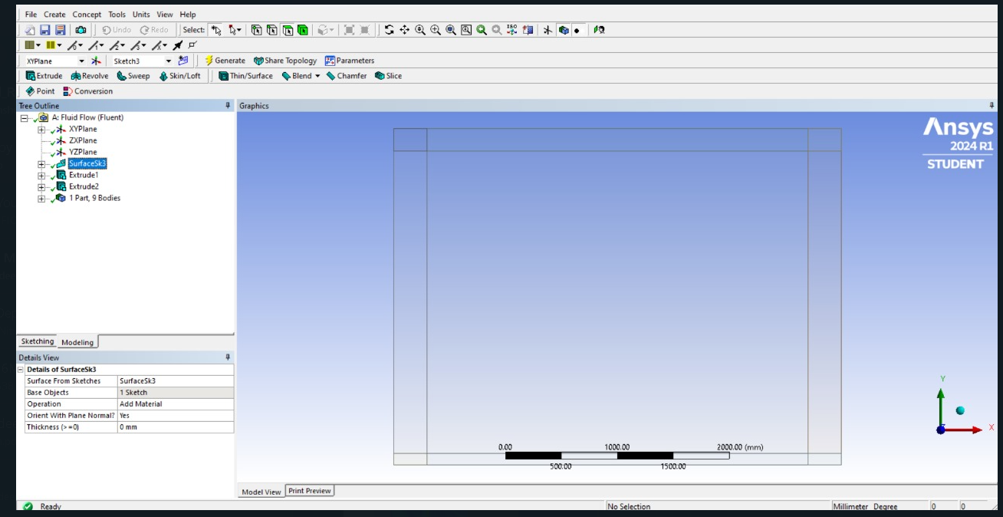
GEOMETRY

Slide 3
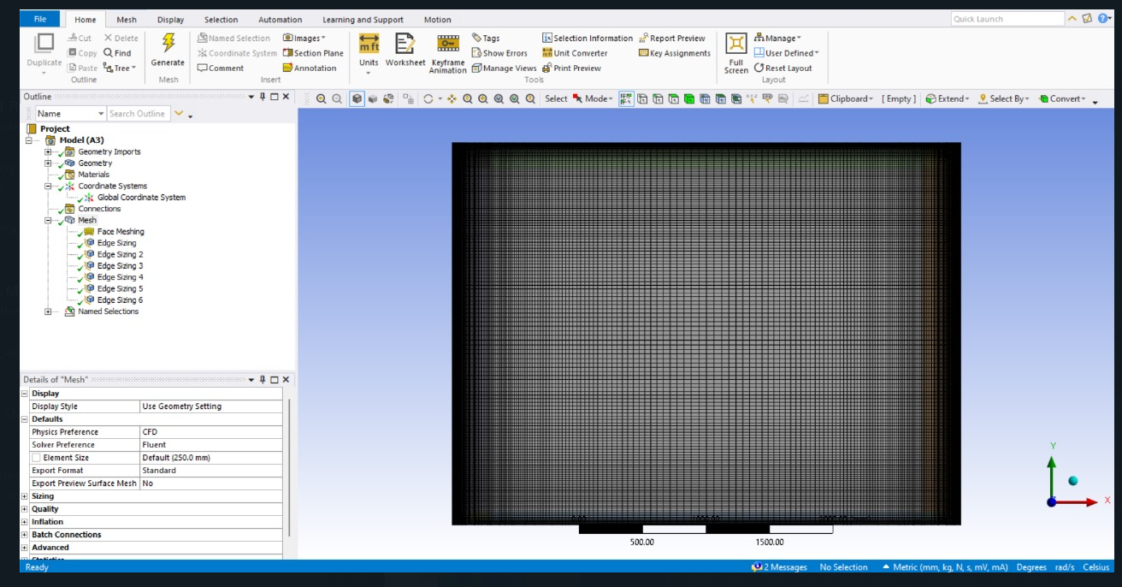
MESHING

Slide 4
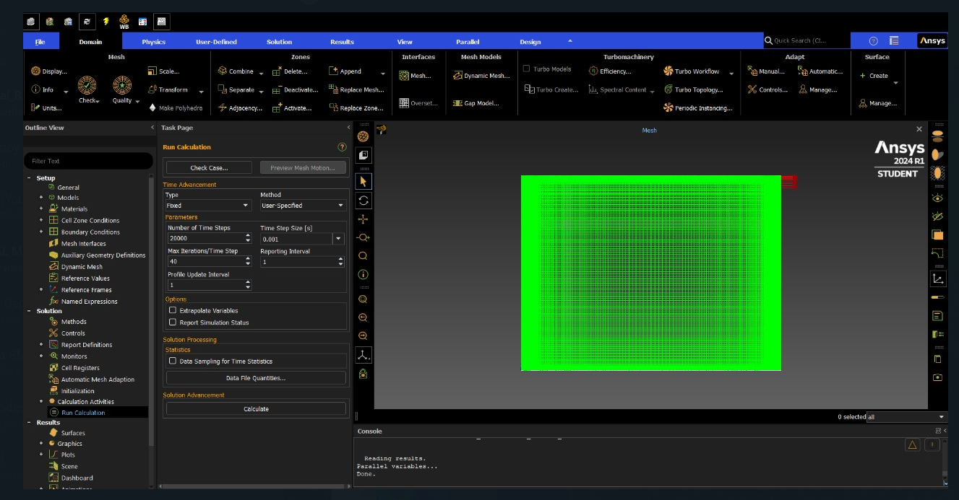
SOLUTION

Slide 5
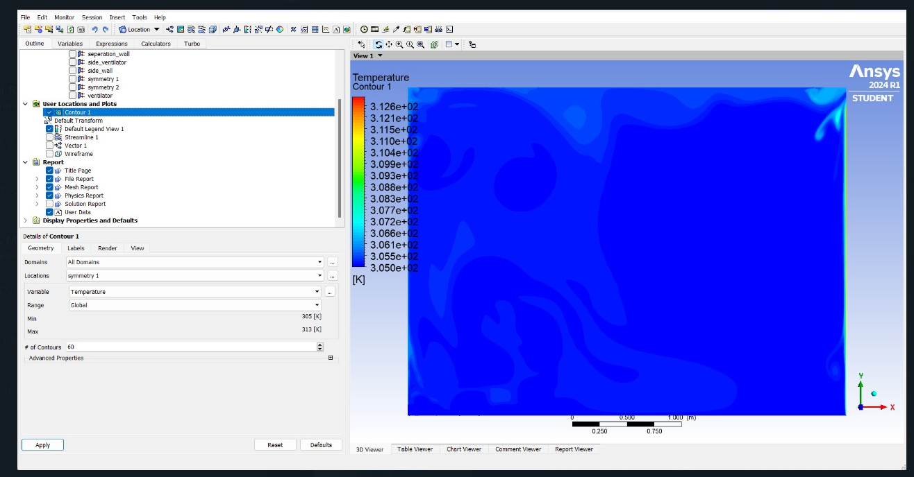
FINAL RESULT(Temparature)

Slide 6
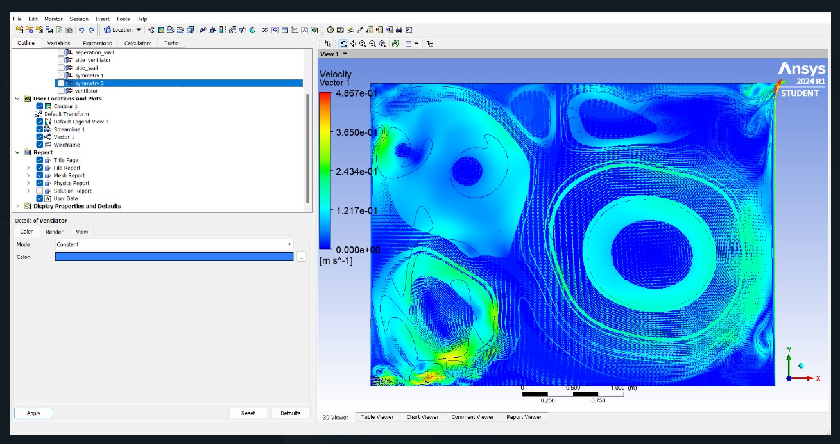
FINAL RESULT(Velocity Vector)

Slide 7
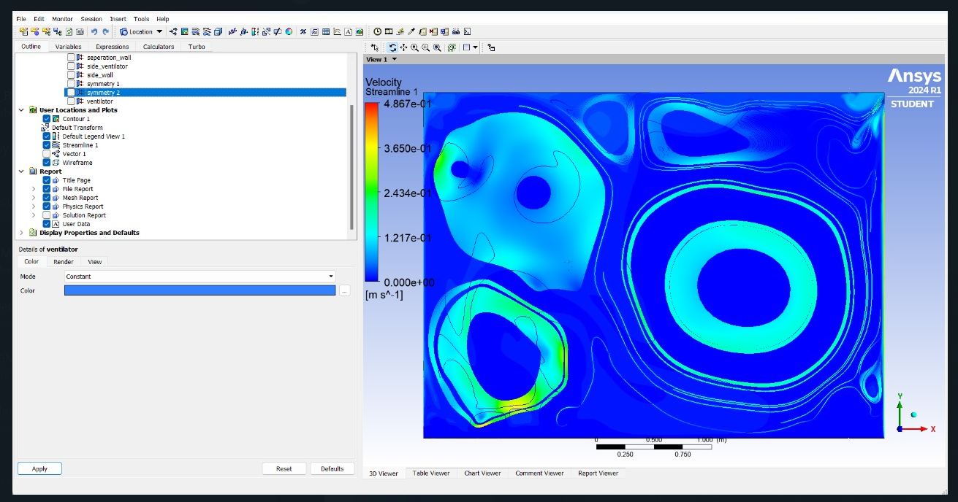
FINAL RESULT(Velocity Streamline

